Slide 1
TNOTE CARDS Case Study

Slide 2
Objective
“Play” with CARDS
Do Forecast/Nowcasts for 18 Nov 2011 case
  Parana Radar

Slide 3
Procedure
Based on Sounding/Maps – Fcst for the day (Part 1)
  Shear/CAPE -> storm type
  what is your forecast/watch/advisory?
  When? Where? What?
Review Radar Data from 0000-0030Z (Part 2)
  Familiarity with CARDS
  Make a warning
  Where: Nowcast/warning for the points indicated on the following map
  Start-Stop
  Heavy rain? Hail? Wind?
Repeat 0030-0340 (Part 3)
Repeat 0340-0500 (Part 4)

Slide 4
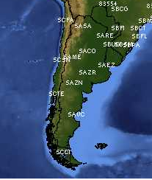

Slide 5
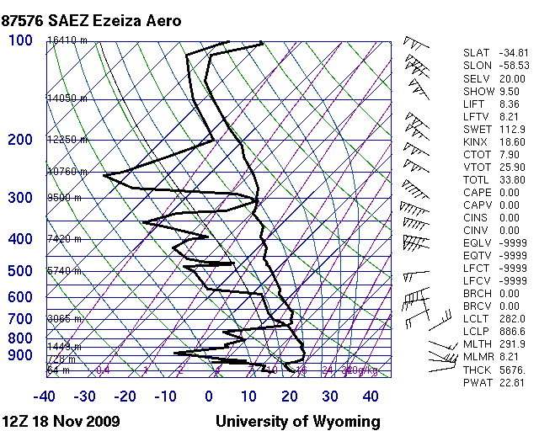
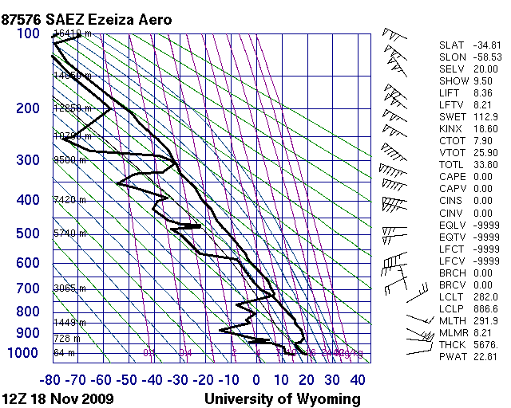

Slide 6
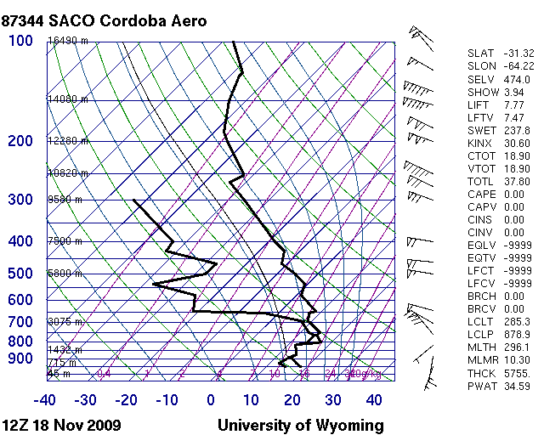
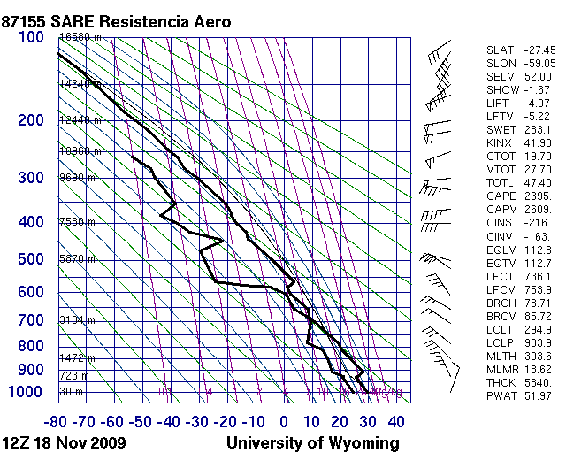
1 bar = 10 knots

Slide 7
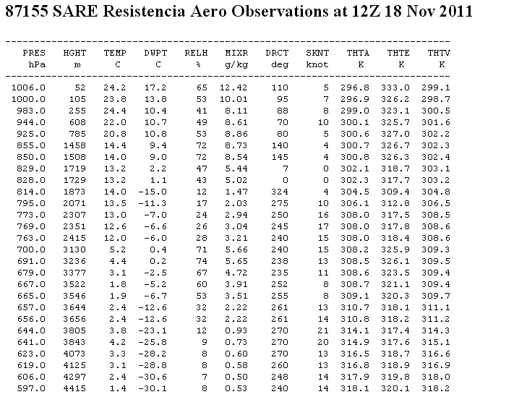

Slide 8
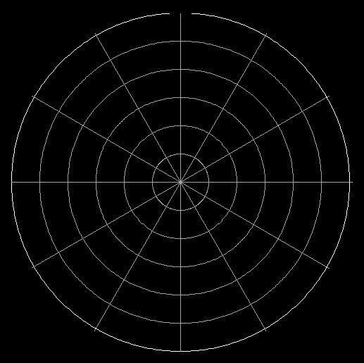
Hodograph to calculate shear
5 10 15 20 15 30 Knots

Slide 9
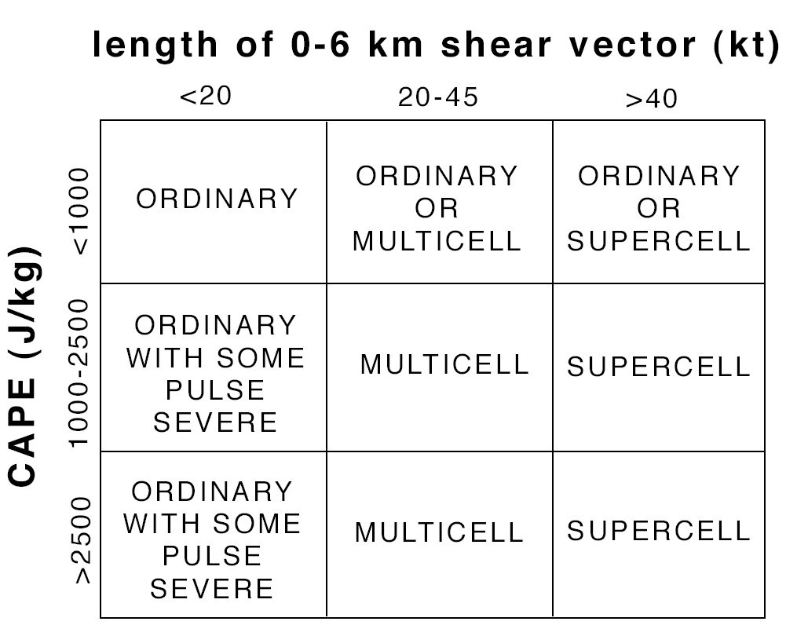
Theoretical CAPE-Shear and Storm Type

Slide 10
Groups 1,4,7 do point A
Groups 2,5,8 do point B
Groups 3,6,9 do point C
A
B
C

